Slide 1

Notes:
Welcome…let’s give a huge round of applause to our very talented Cass High theater, chorus, and band students. If you would like to know more about any of these programs or how to sign up to be part of the action, there will be a representative for each program set up in the media center ready to answer all of your questions.

Slide 2

Notes:
Good Evening, I am Micaela Armona the Magnet Coordinator here at Cass High School.

Slide 3
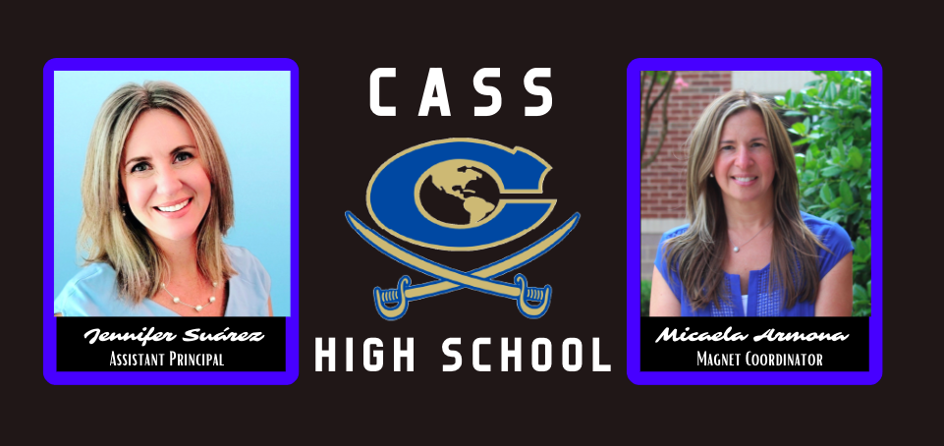

Slide 4

Notes:
Mr. Revard’s slide for reference.

Slide 5



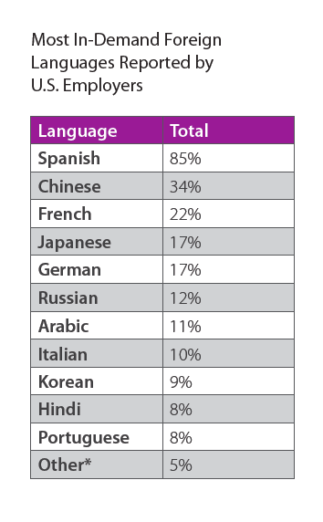
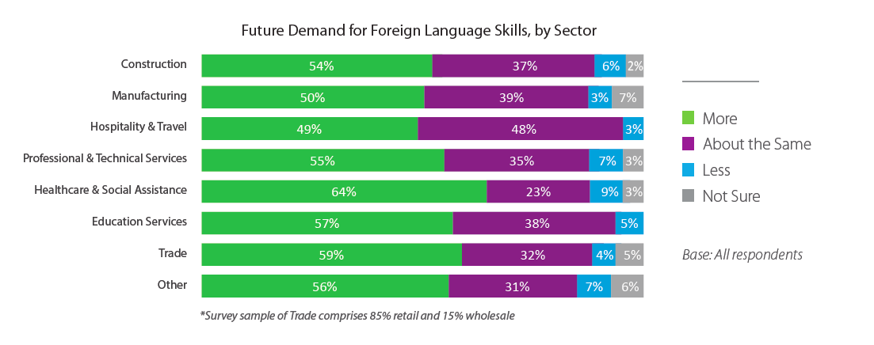
teacher • lawyer • interpreter • translator • doctor • nurse • writer
businessman • law agent • ambassador • tour guide • liaison officer
sports commentator • missionary • researcher • speech language pathologist • therapist • exercise scientist • engineer • management
military officer • marketing sales representative • journalist • analyst
ETCETRA
Notes:
Some students absolutely know that they want to be an engineer or architect, while some students may be still figuring out what their future holds. An added advantage of our program is that no matter what academic or career paths our students decide to take, they will leave here with skills needed to not only compete in the global market but with an advantage.

Slide 6
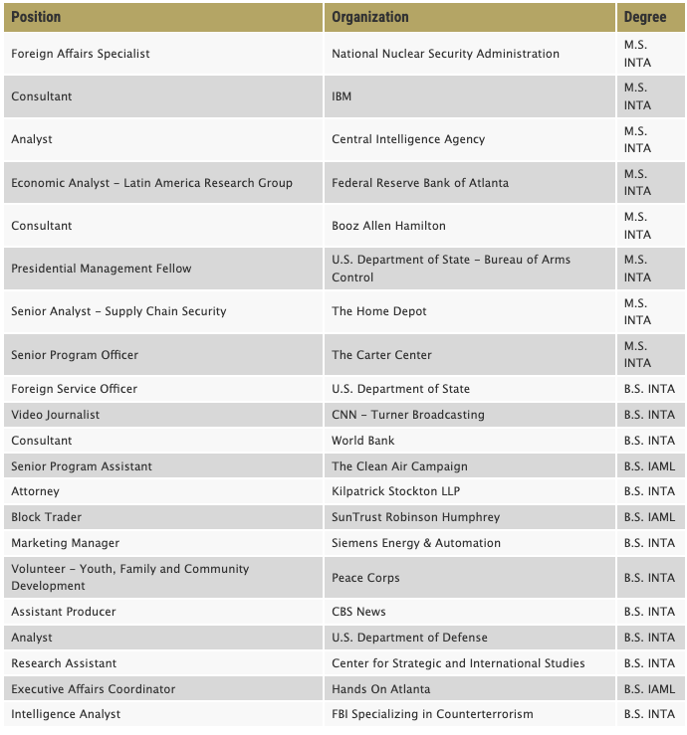
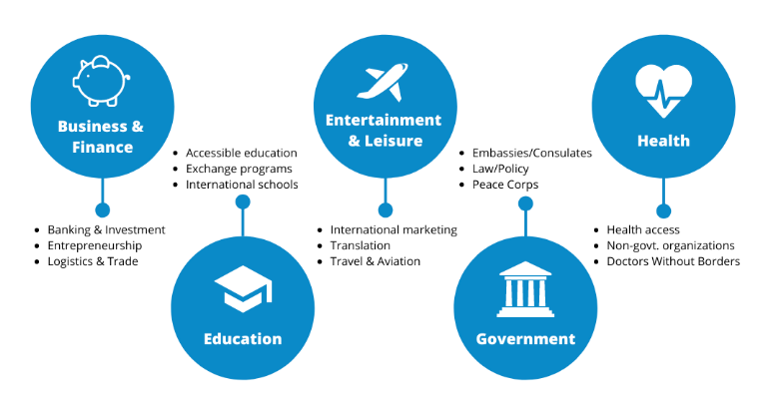
Careers in International Studies

Slide 7
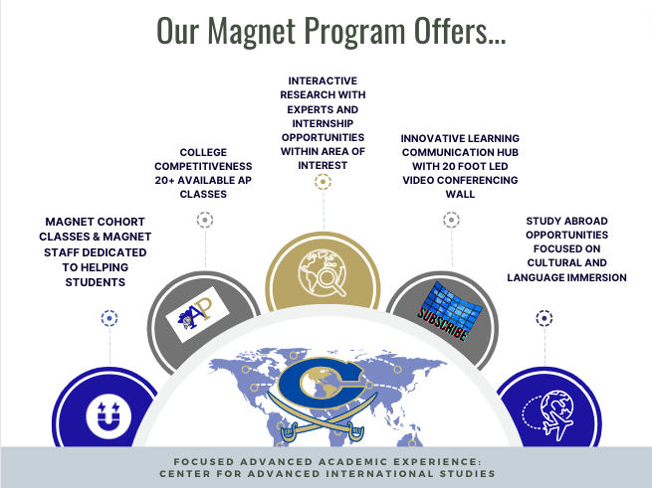

Slide 9
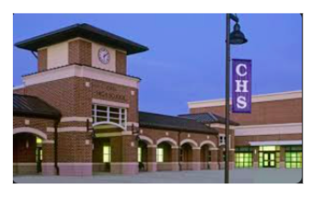
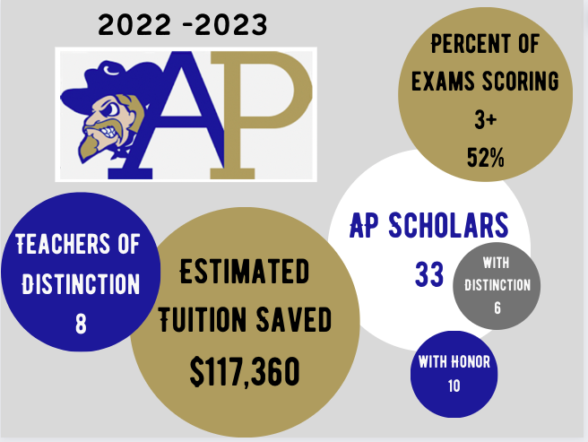
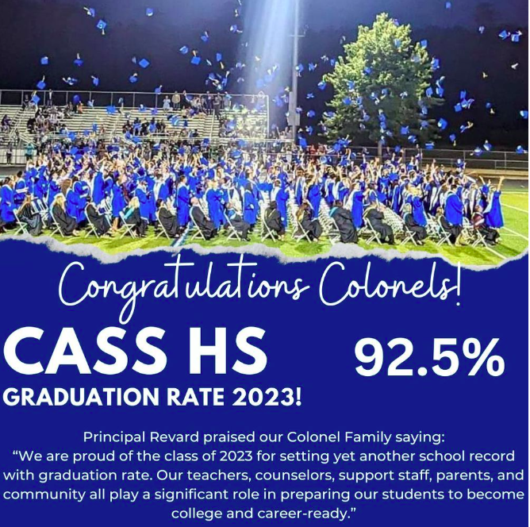
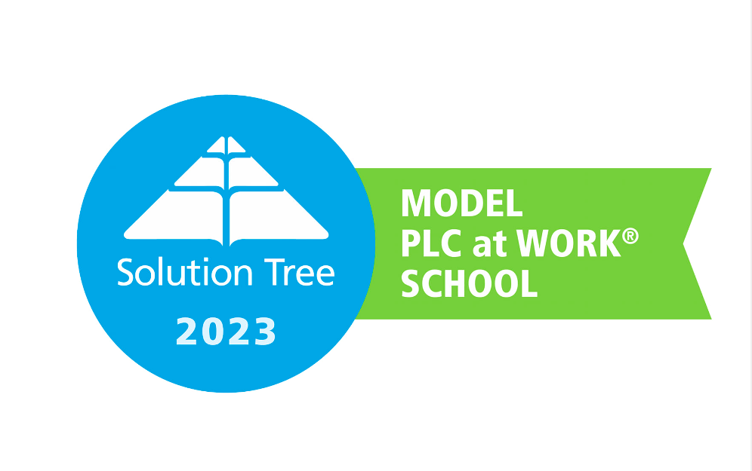

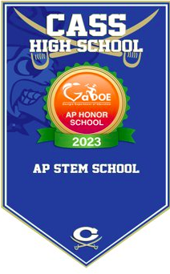
ACADEMICS
Notes:
Last year we had 50 students recognized by College Board for excelling in 3 or more of their AP tests. We also had 3 teachers recognized as AP teachers of distinction, meaning that at least 80% of their students took the exam and more than 50% of the students passed the exam with a 3 or higher. In addition to our many CTAE, world language, and academic diploma seals,
Our program focuses on providing students with interactive research opportunities with experts in the field and internships in their areas of interest. In order to better serve our students’ interests and provide them many career path options, I am excited to say that we are adding 2 new CTAE pathways and new courses. For each of these courses, we have already begun making community partnerships and planning future projects. For example, Dr. Mary Ritz, an international entrepreneur, CEO of Almenta, and marketing expert did a presentation with our students in September. She was so impressed with our students that she has committed to helping with our international business pathway, mentoring our students, and she is here tonight answer questions about how a background in international studies and languages can help you succeed. Additionally, I was able to connect with Dr. Craft, who not only wrote the curriculum for GA DOE for this couse, but she literally wrote the book On National Security and Central Intelligence. She has not only agreed to do virtual seminars with our students but she is also working to arrange a tour of an intelligence agency while our students are touring DC next fall.

Slide 10
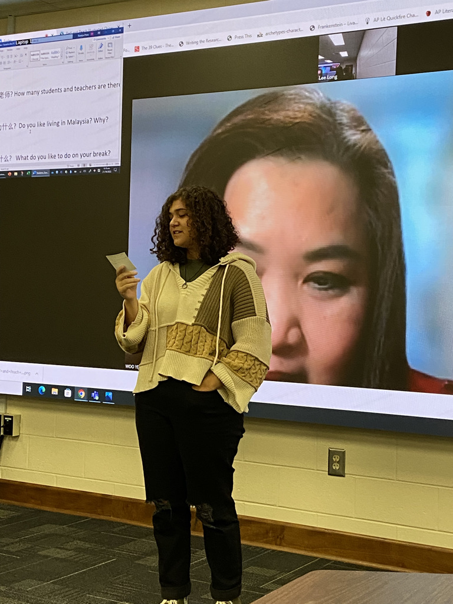


Global Perspective: An international studies magnet program provides students with a unique opportunity to gain a global perspective. In an increasingly interconnected world, understanding different cultures, languages, and global issues is invaluable. Students will be better equipped to thrive in a globalized workforce.
Language Skills: Mastery of a second language is a significant asset in many career paths. Students in this program can become proficient in a foreign language, enhancing their marketability and communication skills.
Notes:
As part of the Magnet experience, student will have some cohorted classes each year. A cohorted class means that the class is populated strictly with magnet students. These classes allow our students to build stronger relationships with each other, have a built-in support system, and can have curriculum tailored to our purpose and goals. Not all of our classes are cohorted. Our students get plenty of opportunities

Slide 11
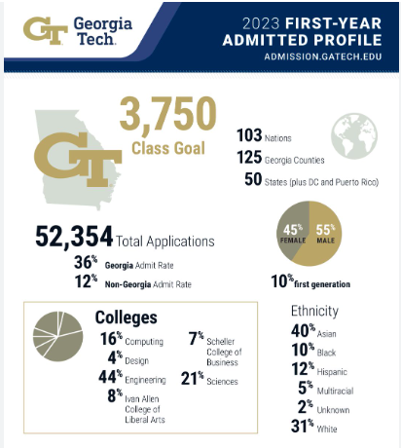
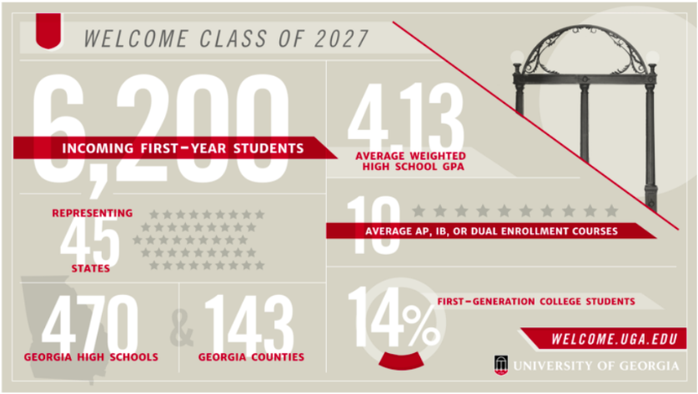
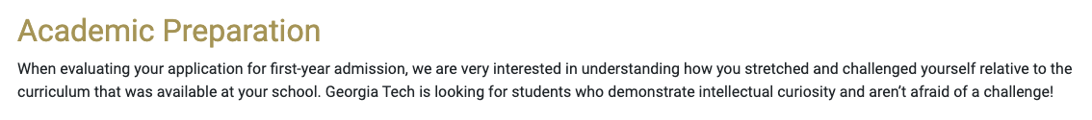
Academic Rigor: Our program involves in-depth research, critical thinking, and analytical skills development. We offer over 23 Advanced Placement courses as well as unique CTAE pathways. These courses make a student's academic transcript more impressive and demonstrate a commitment to challenging coursework.
Being part of our Magnet Program provides you with opportunities to stand out to colleges.

Slide 12
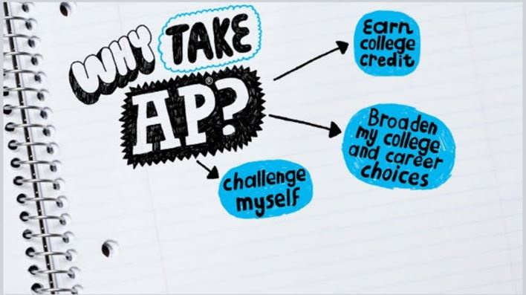
Looking Toward the Future
Academic Benefits
Many colleges have become test optional, no longer requiring the SAT or ACT; however, because of this, the role of student enrolment & success in AP courses has gained more significance for college admission purposes.
Comparison studies examining the academic performance of AP vs. non-AP students show AP students have:
higher standardized test scores
higher college attendance rates
higher likelihood of majoring in a field related to AP coursework
higher college graduation rates
stronger writing ability in college for students who take AP English
higher rates of obtaining advanced degrees and higher future incomes
Start earning college credit as a 9th grader
Support within your school and online resources
More competitive applicant to colleges
AP courses are weighted more heavily in calculating students’ GPAs, potentially boosting students’ GPAs and their overall chances of college admissions
AP curriculum is standardized and well known to colleges
Current Research Says
Impact of AP on College Admissions
A 2018 survey conducted by National Association for College Admissions Counseling revealed that the top two factors cited in admission decisions were:
  overall school GPA & grades in rigorous courses
  Admission test scores and the strength of curricula

Slide 13
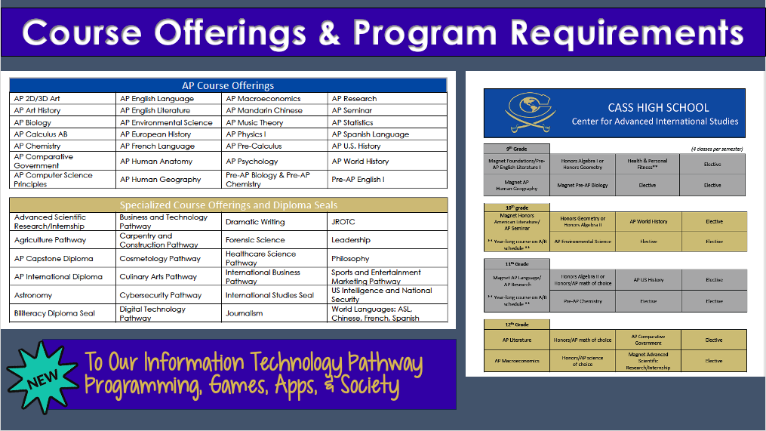

Slide 14
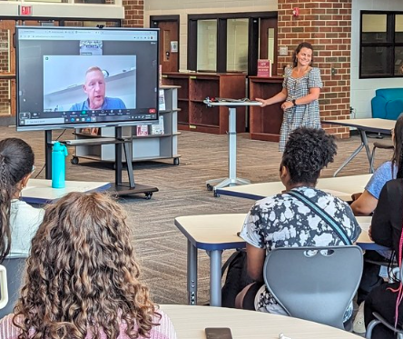
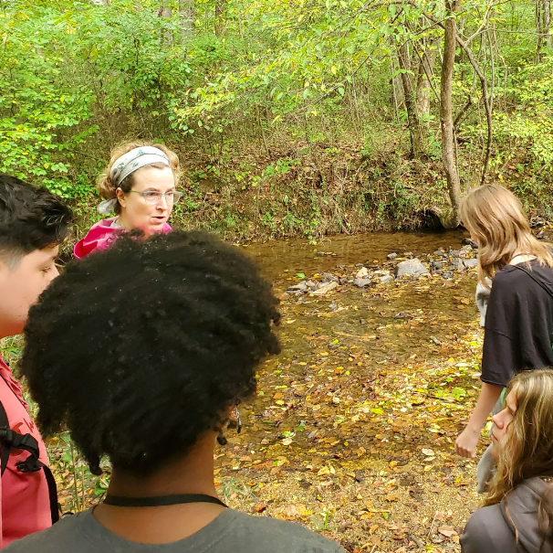
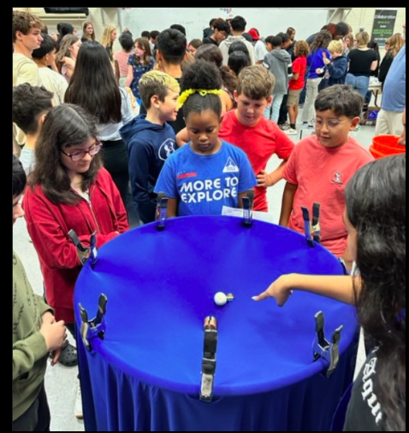
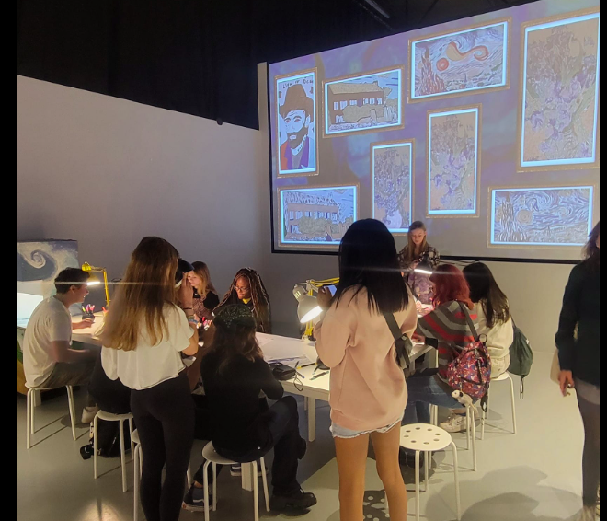
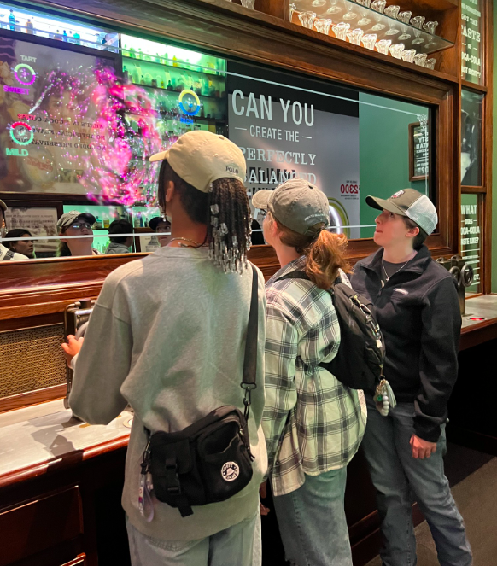
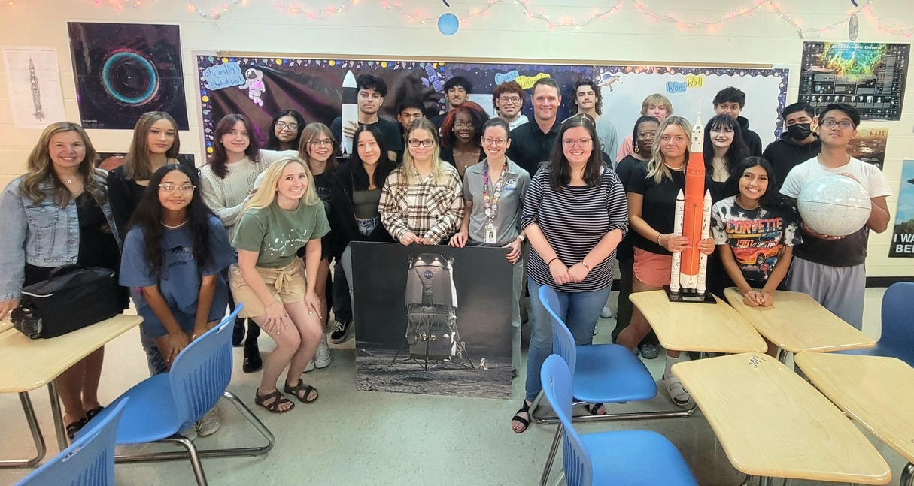
Experiential Learning
Experiential Learning is the process of learning by doing. By engaging students in hands-on experiences and reflection, they are better able to connect theories and knowledge learned in the classroom to real-world situations.
These opportunities exist in a variety of course- and non-course-based forms and may include community service, service-learning, research, study abroad/away, guest speakers, and culminating experiences such as internships and our AP Capstone program.

Slide 15


Slide 16


Slide 17

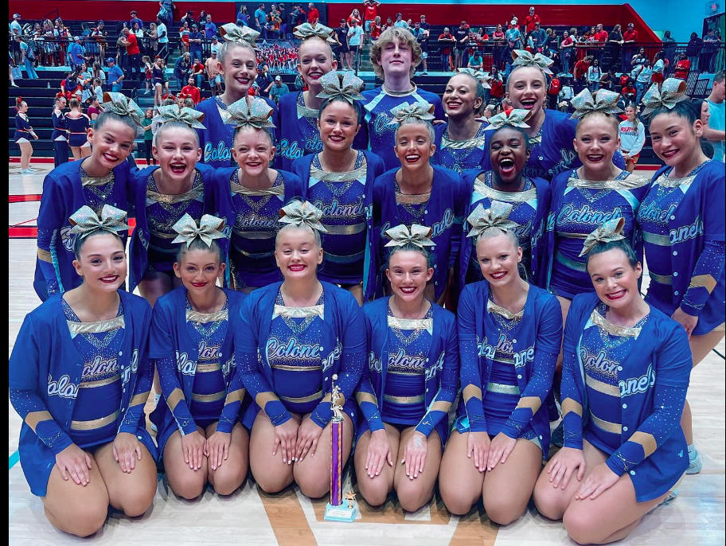
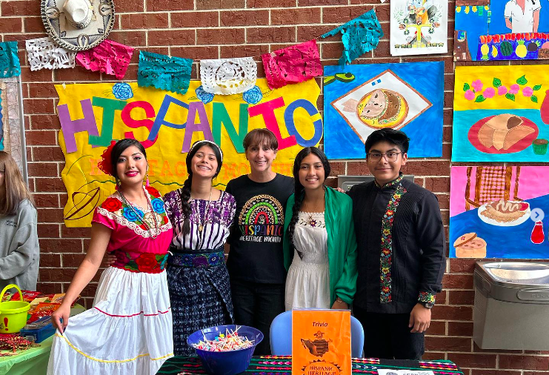
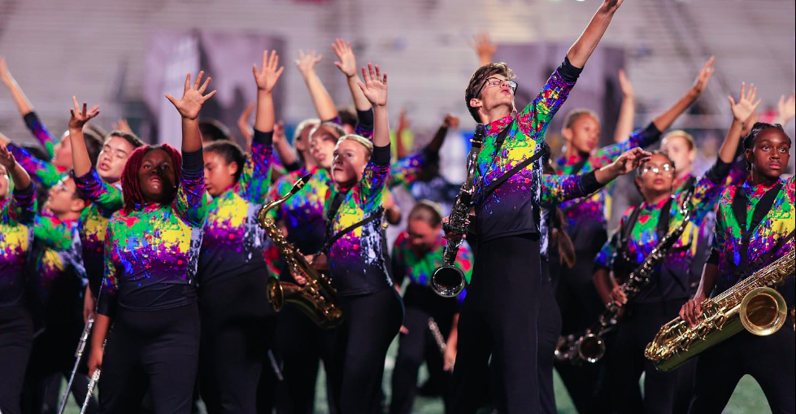

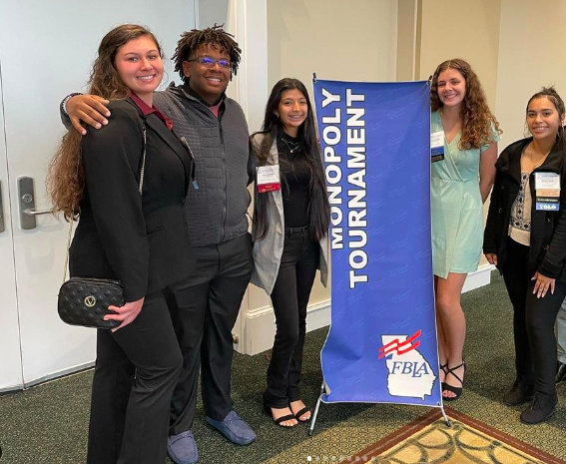
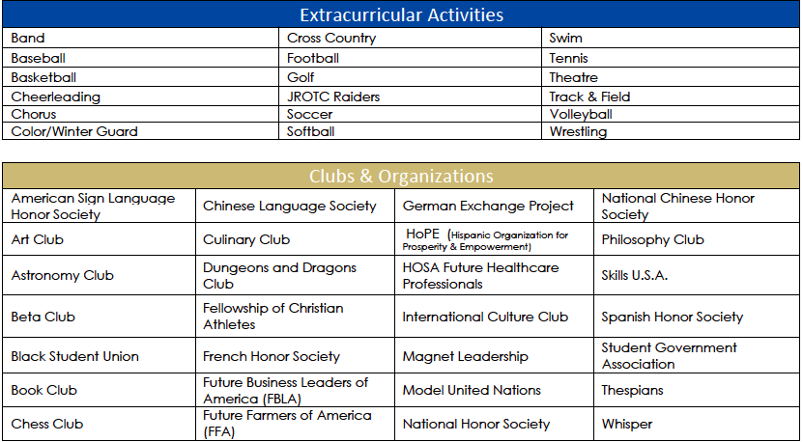
Community

Slide 18
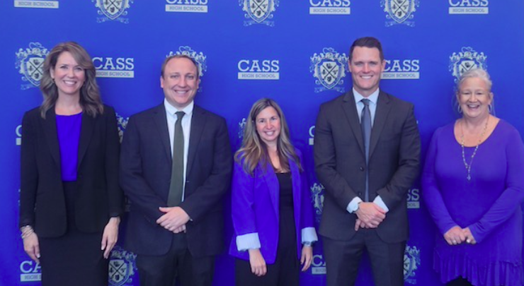
Joining Our Magnet Community
Our magnet program offers specialized curricula takes into consideration students' specific interests. This leads to a more engaging and tailored education, as students can focus on their passions and talents.
Cohorted classes foster a close-knit community among students.
Increased Collaboration: magnet courses classes often require students to work together on group projects, assignments, and discussions.
Peer Support: students in the magnet community can provide emotional and academic support to one another. This peer support can be particularly valuable during challenging times or when students need help with their coursework.
Enhanced Extracurricular Opportunities: we offer a wide variety of clubs, sports, field trips, international travel, and engaging cultural experiences. The BEST part--you get to help choose these activities.
Your Magnet Support Team
Mrs. Jennifer Suárez--Assistant Principal / Curriculum Supervisor
Mr. Andrew Griffin--Lead Counselor/Magnet Counselor
Mrs. Micaela Armona--Magnet Coordinator/AP Curriculum Coordinator
Mr. Stephen Revard--Principal/Magnet Enthusiast
Mrs. Kelli Bryson—Magnet Clerk/AP Clerk

Slide 19
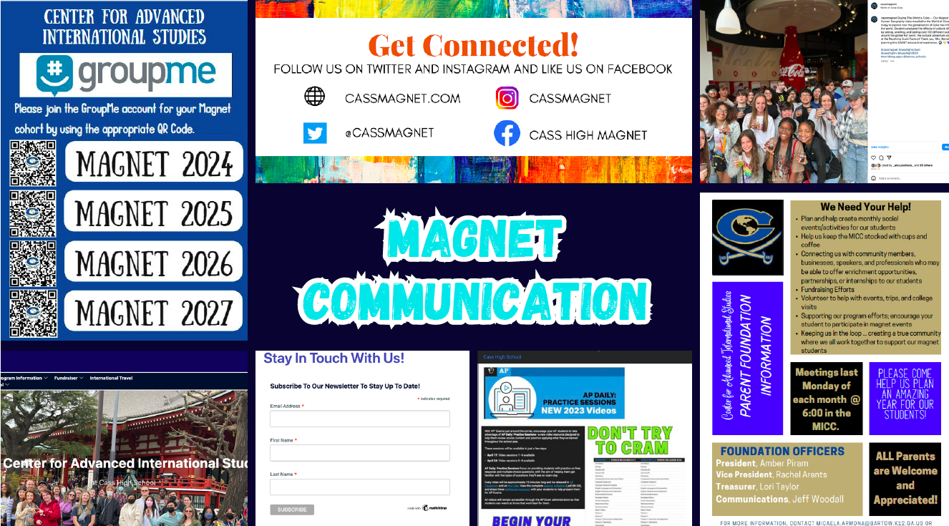

Slide 20
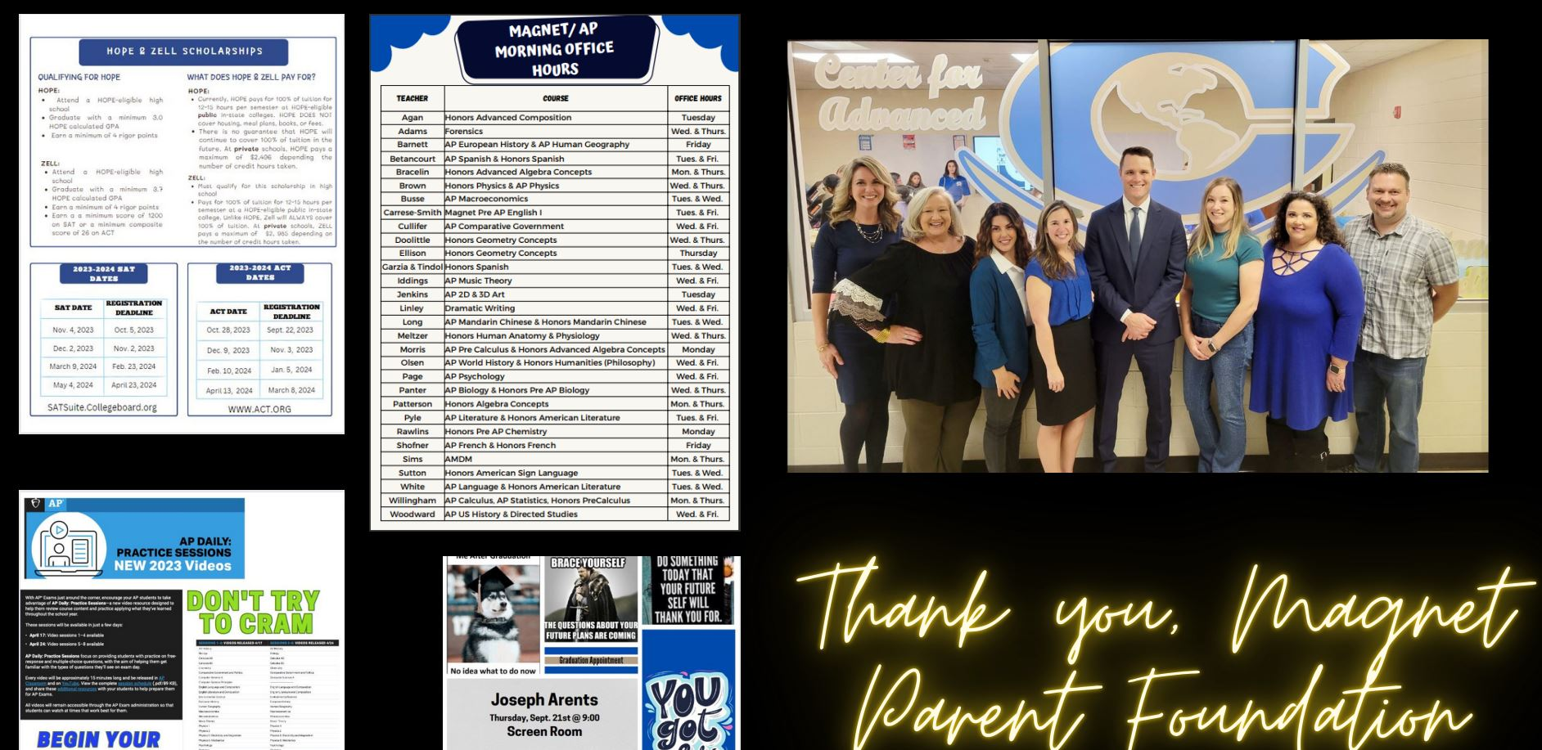

Slide 21

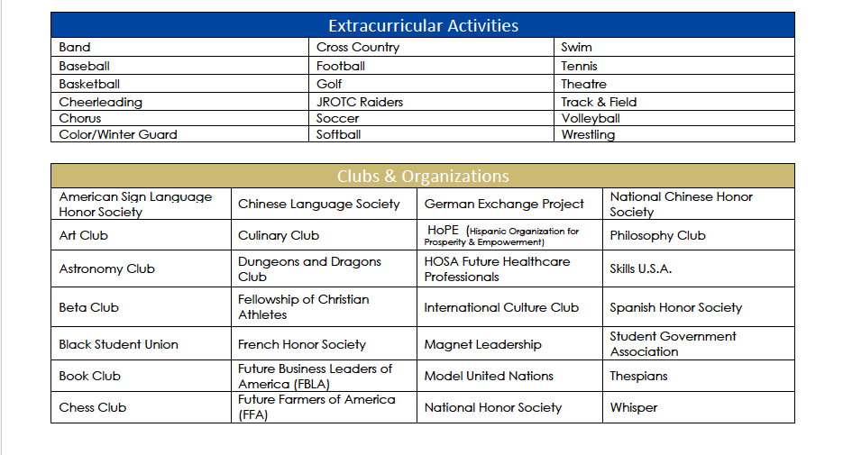
1500 students
4x4 block
Gold Time
4 lunches & 4 transitions
Remediation & Enrichment
80 minute classes
Leadership

Slide 22
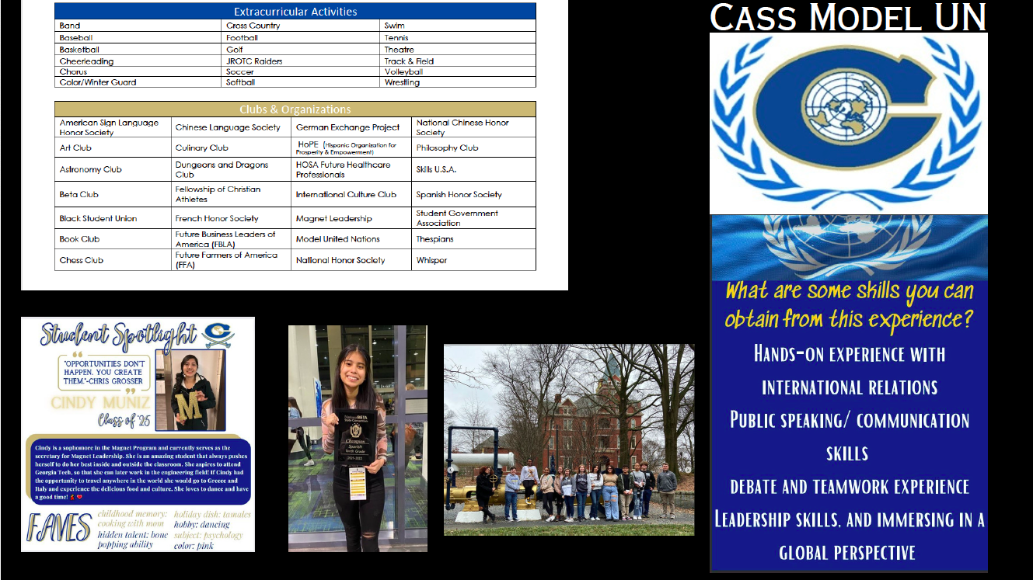

Slide 23
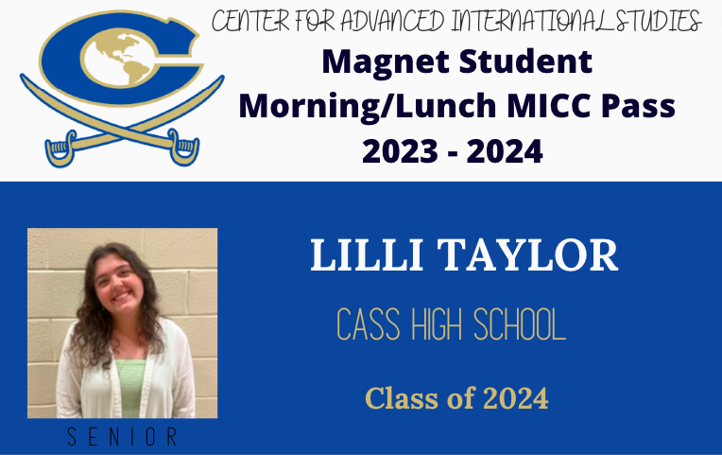
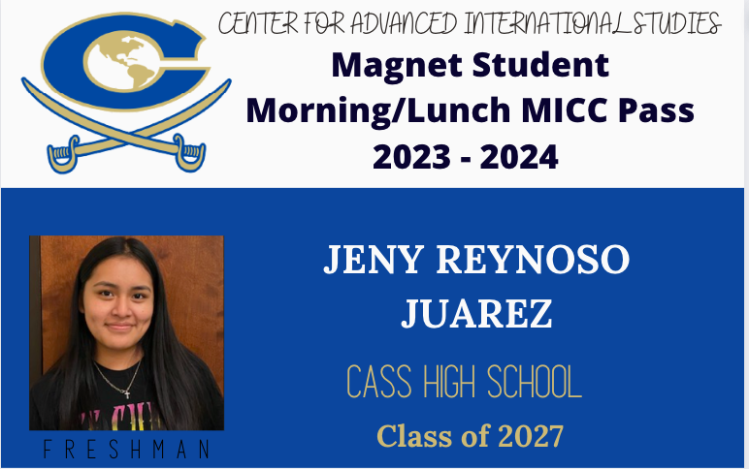
Students’ Perspective
Magnet Leadership
Model UN
HoPe
Magnet Leadership
Band
ASL Honor Society
GHP Attendee
AP Scholar
Beta Club

Slide 24
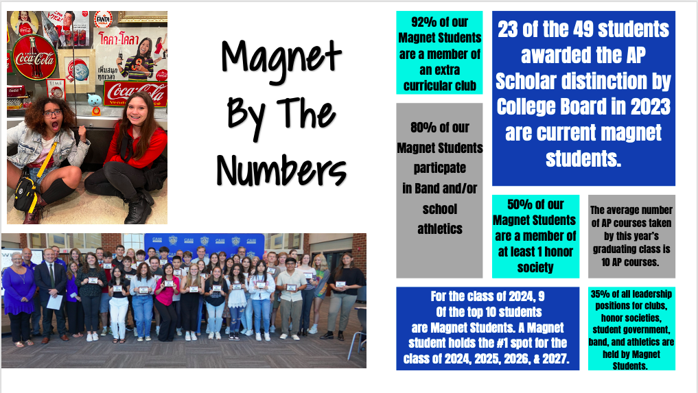

Slide 25
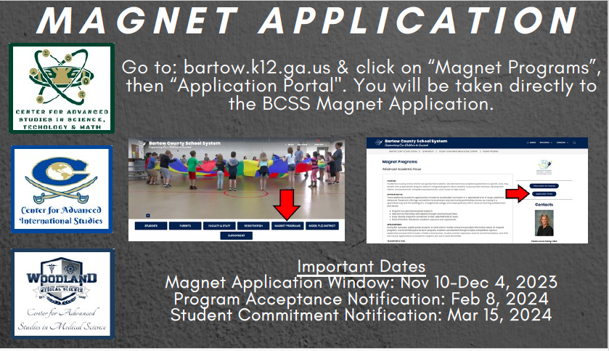

Slide 26


Slide 27


Center for Advanced
International Studies

